Slide 1

Your Instagram : HTML/CSS/JAVASCRIPT

Slide 2
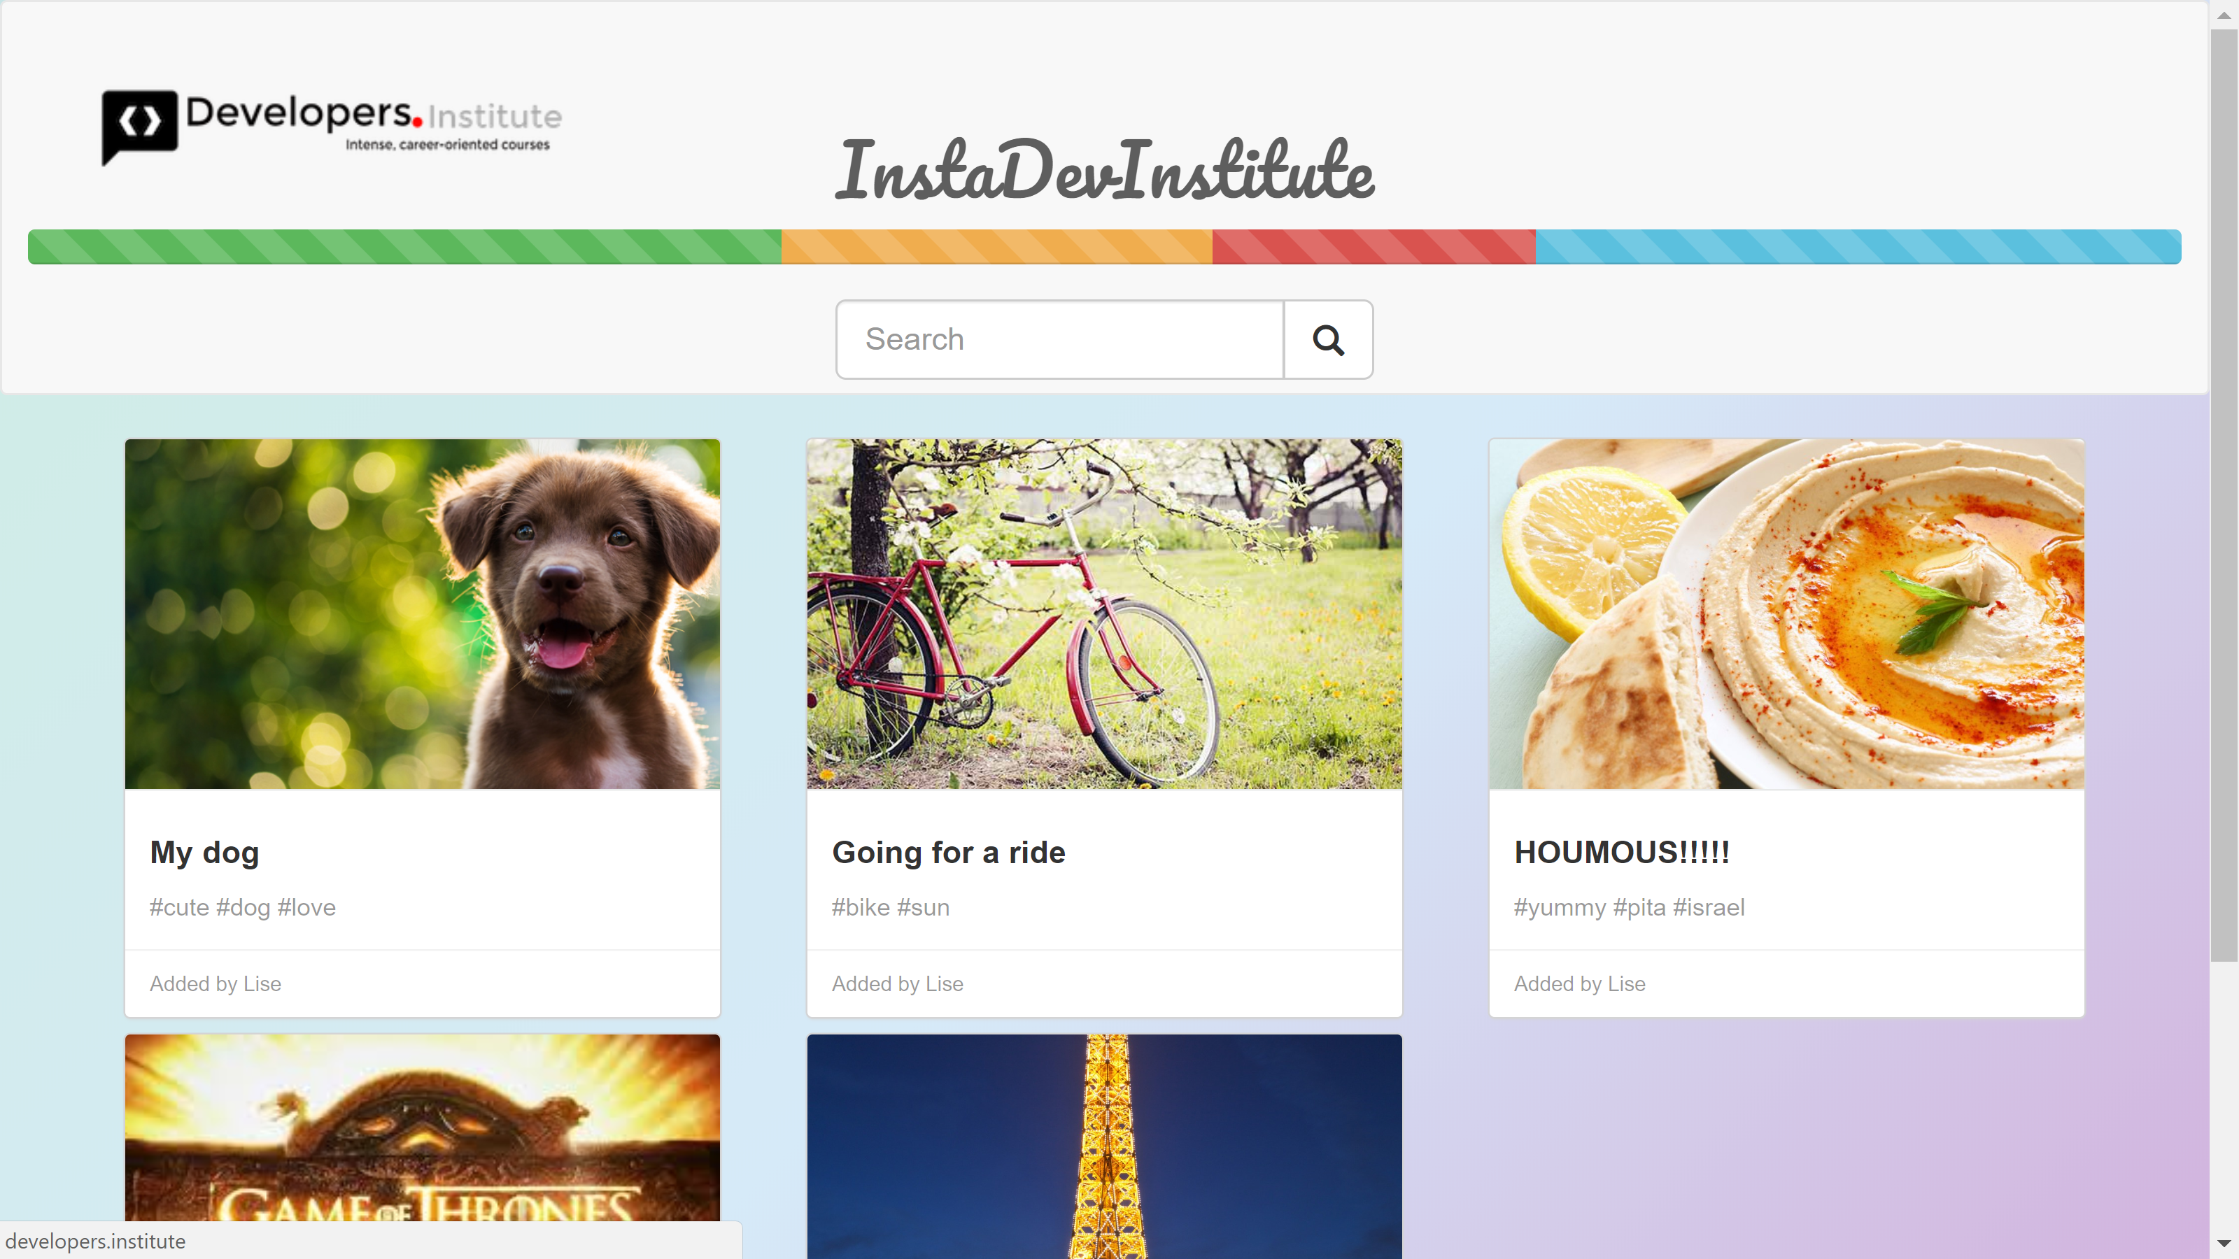

Slide 3
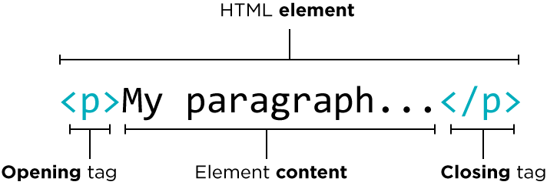
INTRODUCTION TO HTML
HTML : skeleton of all web pages.
The tags in HTML

Slide 4
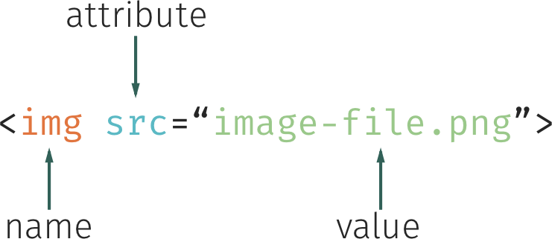
There are also self-closing tags. They don’t have a
closing tag
The attributes in HTML
Attributes complete the elements by defining them more precisely or by providing them with additional information.

Slide 5
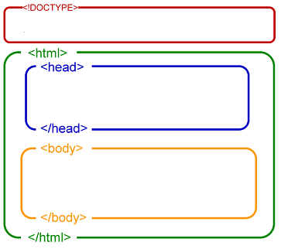
Structure of HTML
The <html> element
It’s composed of two tags : <html> and </ html> and represents our HTML page itself. We will insert all the content of our page inside.
The head element
It contains meta information about the page. It’s general information that the page will need to work, such as :
the title of the page
the type of encoding used.
Links to other pages
The body element
It contains all the "visible" content of the page: texts, images, links, videos, etc.

Slide 6
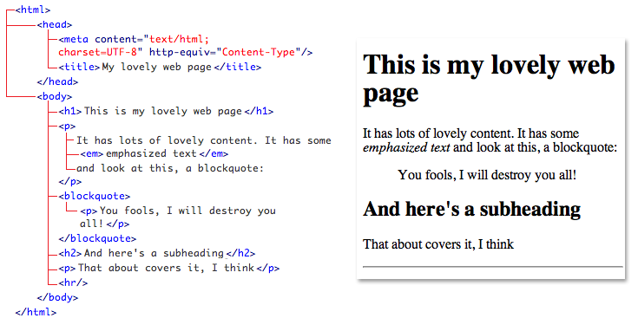

Slide 7
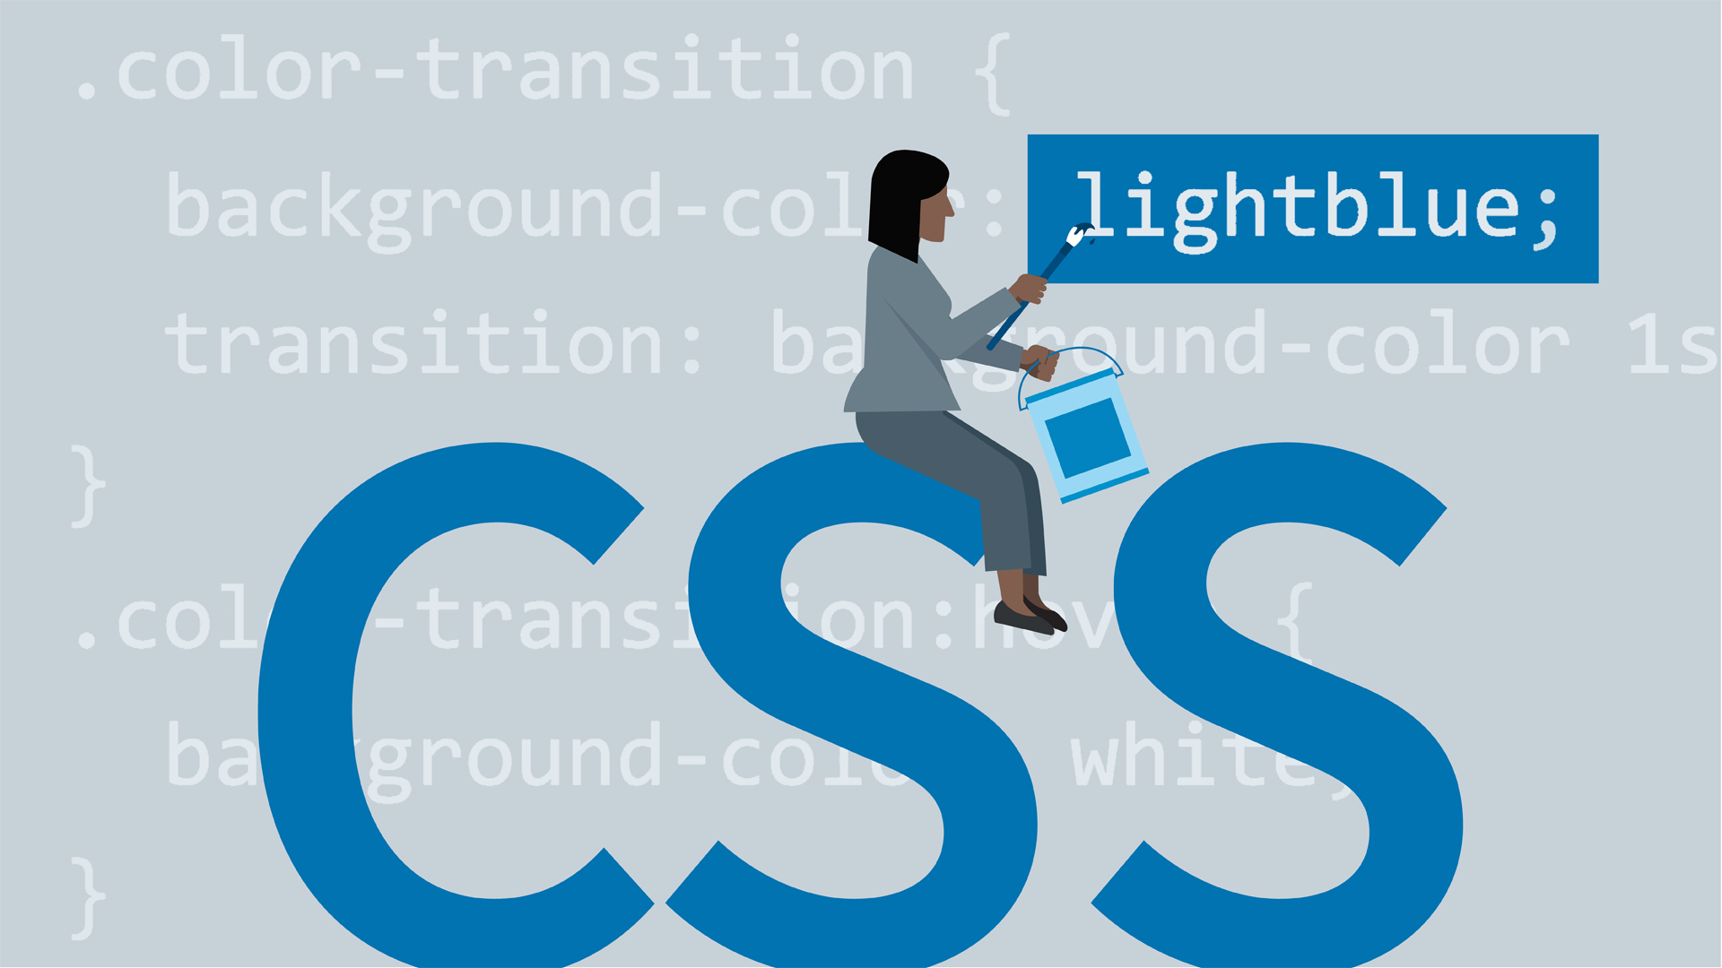
INTRODUCTION TO CSS
CSS, or Cascading Style Sheets, is a language that web developers use to style the HTML content on a web page. If you're interested in modifying colors, font types, font sizes, shadows, images, element positioning, and more, CSS is the tool for the job!

Slide 8
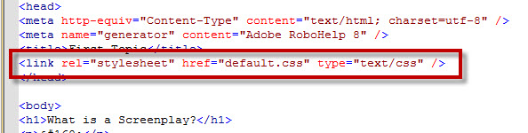
You have to link HTML and CSS files together.
The <link> element, placed within the head of the HTML file. Requires the following three attributes:
href — name of the CSS file
type — type of document that you are linking to : text/css.
rel —relationship between the HTML file and the CSS file.The link is to a stylesheet : stylesheet.

Slide 9
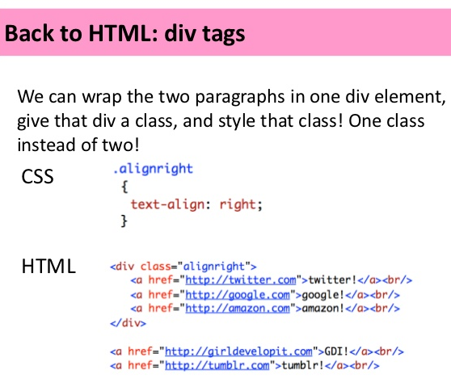
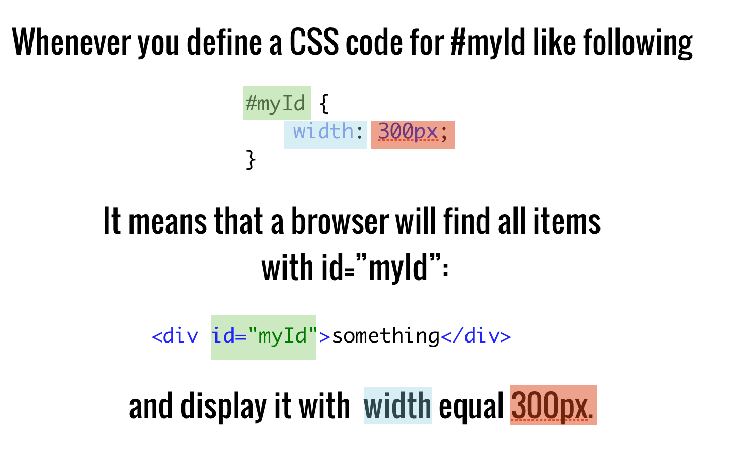
Linking CSS to HTML
CLASSES
ID

Slide 10

INTRODUCTION TO BOOTSTRAP
What is Bootstrap ?
Free front-end framework for faster and easier web development
Includes HTML and CSS based design templates for typography, forms, buttons, tables, navigation, modals, image carousels and many other
Gives you the ability to easily create responsive designs
What is Responsive Web Design? Creating web sites which automatically adjust themselves to look good on all devices, from small phones to large desktops.

Slide 11
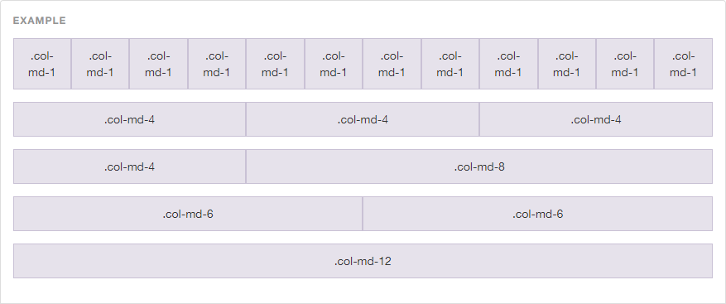
Linking Bootstrap to the HTML file
<link href="css/bootstrap.min.css" rel="stylesheet">
The grid : the most essential aspects of the framework

Slide 12
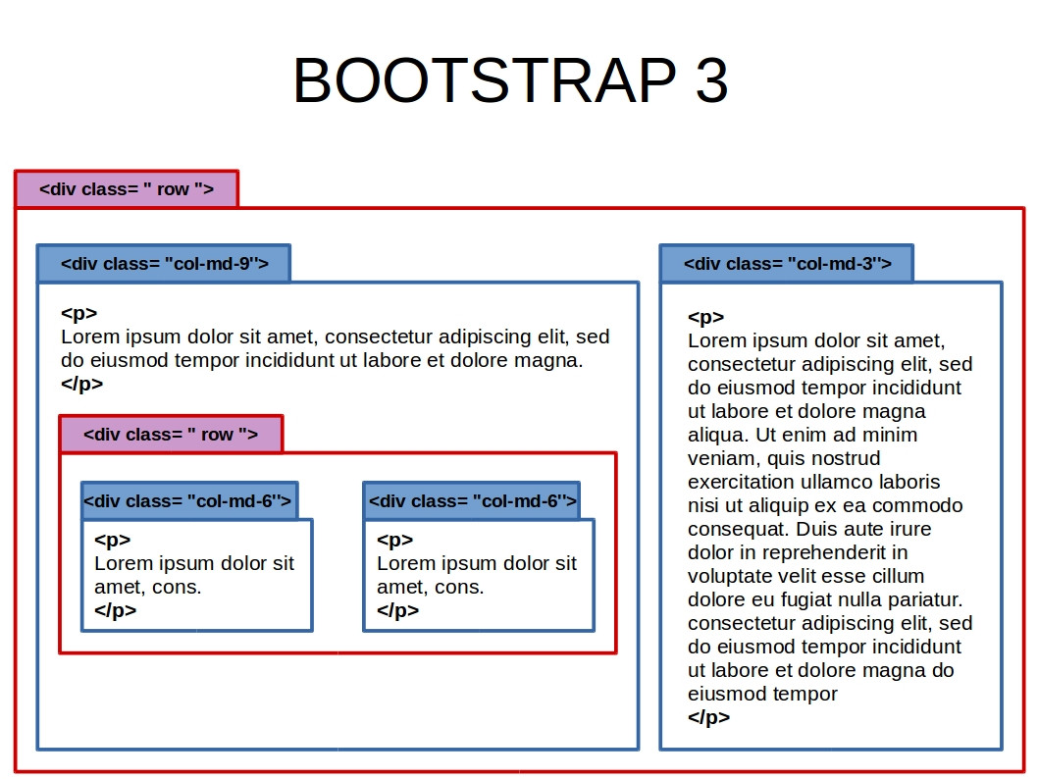
12 COLUMS
<div class="container">
<div class="row">
<div class="col-md-9"> </div>
<div class="col-md-3"> </div>
</div>
</div>

Slide 13
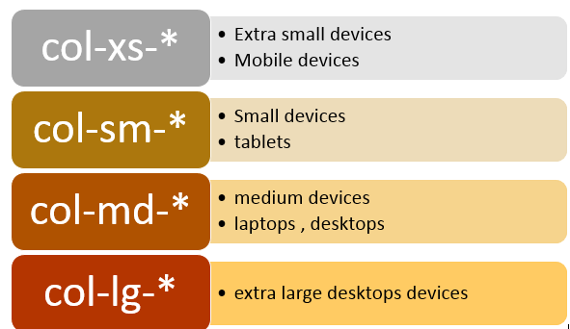
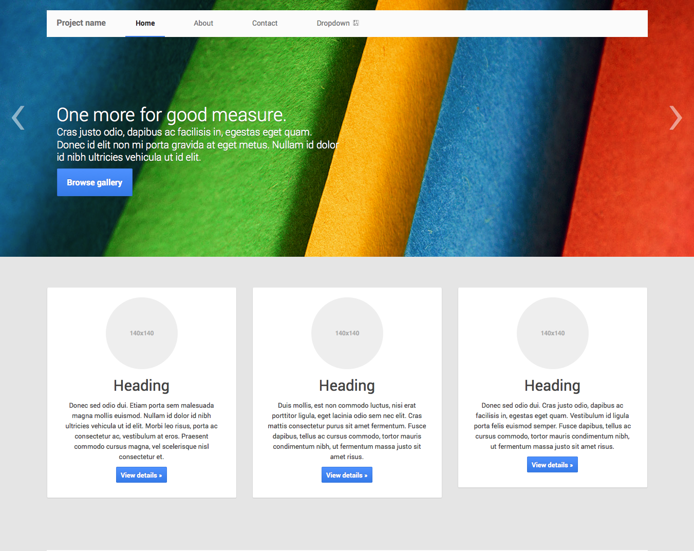
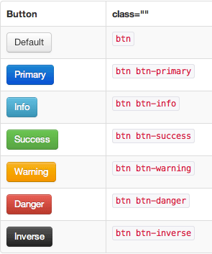

Slide 14


Slide 15


